Slide 1




Slide 2



INTERGOVERNMEN TAL ASSOCIATION.
MANAGE AND PROMOTE TRADE ACTIVITIES FOR SPECIFIC REGION OF THE WORLD.

Slide 3




NAFTA
(NORTH AMERICAN
FREE TRADE AGREEMENT)
SARRC
(SOUTH ASIAN ASSOCIATION FOR REGIONAL COOPRATION)
EUROPIAN UNION (EU)

Slide 4
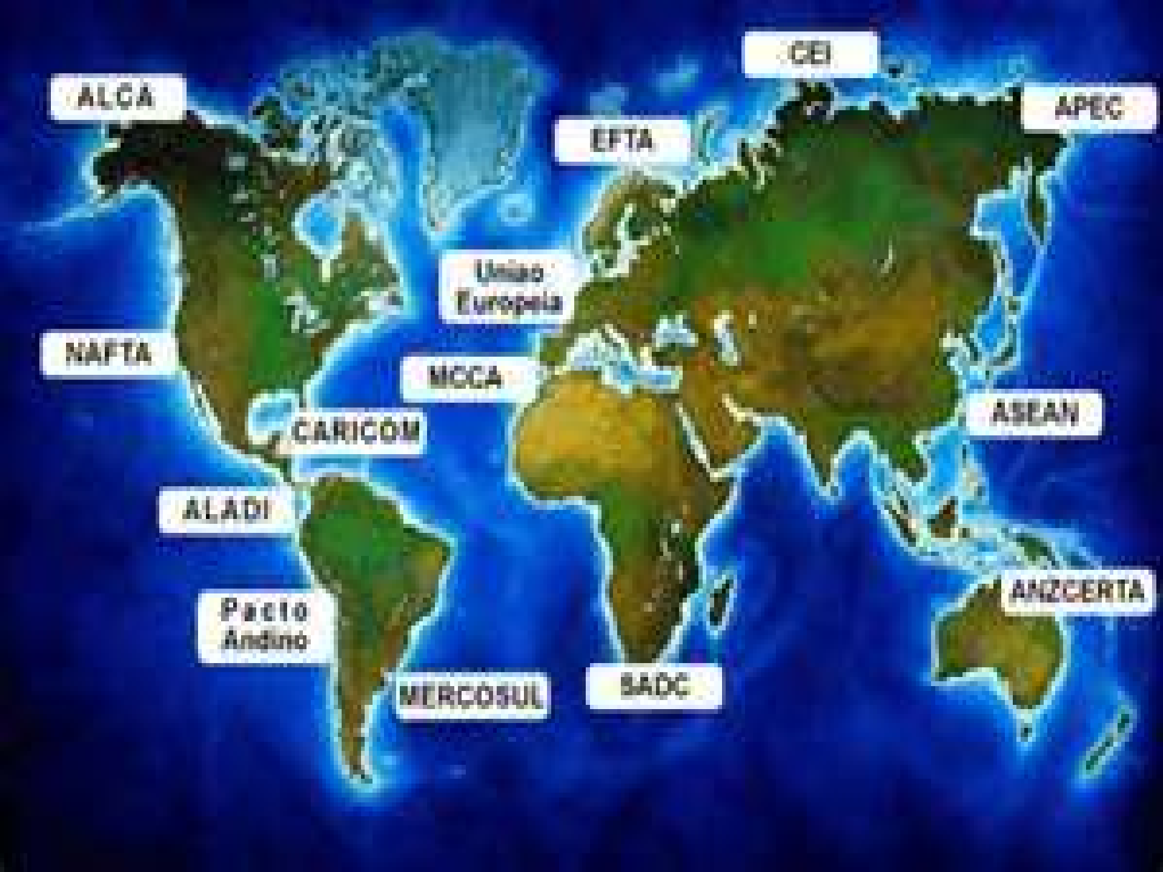

Slide 5
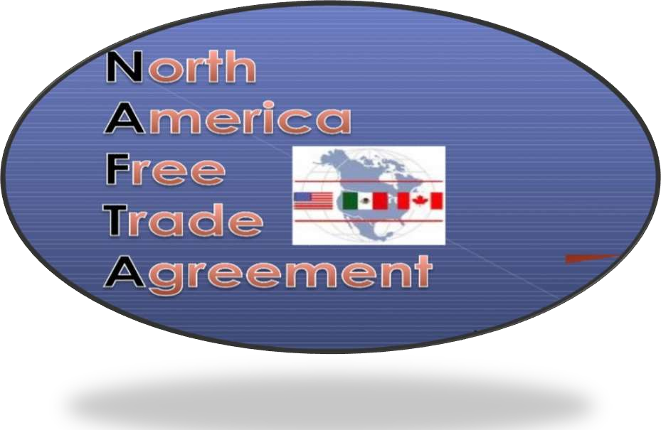


nafta

Slide 6




INITIALLY BILATERAL TRADE BETWEEN U.S. AND CANADA.
IN 1994 MEXICO JOIN THE AGREEMENT.
ESTABLISHMENT OF NAFTA 1ST JAN 1994.
U.S. ,MEXICO, CANADA.
POWERFUL TRADE BLOC.
GNP GREATER THAN 15 EU MEMBER.

Slide 7


DUTY FREE MARKET ACCESS
TRADE RULES: SAFEGUARD, SUBSIDIES, COUNTERVAILING AND ANTIDUMPING DUTIES, HEALTH AND SAFETY STANDARDS.
RULES ON TRADE IN SERVICE AND INVESTMENT.
PROTECTION OF INTELLECTUAL
PROPERTIES.
DISPUTE SETTLEMENT MECHANISM.

Slide 8
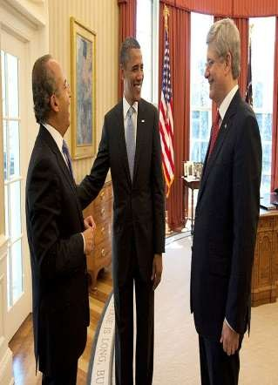
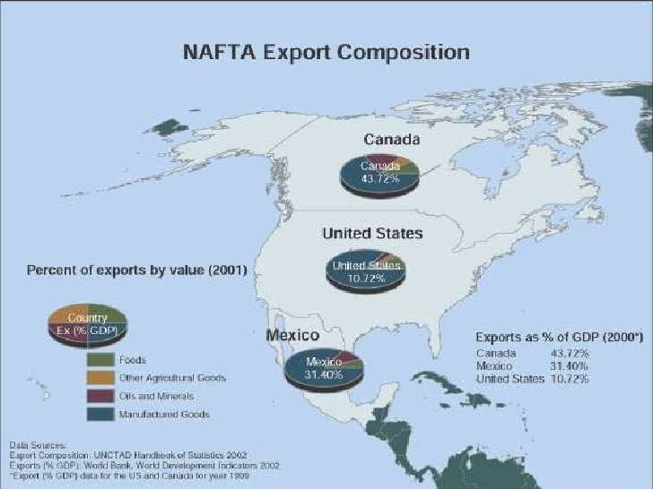
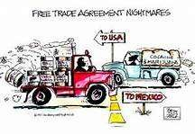

Slide 9



sarrc

Slide 10


ESTABLISH IN DECEMBER 1985.
INDIA ,BANGLADESH, PAKISTAN, NEPAL, BHUTAN, SRI LANKA, MALDIVES.
GOAL OF SARRC IS ACCELERATE ECONOMIC AND SOCIAL DEVELOPMENT.
SOLVING THE REGIONAL PROBLEMS OF RESOURCES.

Slide 11



IMPROVE QUALITY OF LIFE & WELFARE OF THE
PEOPLE OF THE MEMBER COUNTRY.
DEVELOP THE REGION ECONOMICALLY ,SOCIALLY & CULTURALLY.
OPPORTUNITY TO THE PEOPLE OF THE REGION TO LIVE IN DIGNITY& EXPLOIT THERE POTENTIAL.
ENHANCE MUTUAL ASSISTANCE IN THE AREAS OF
SOCIAL CULTURAL, SCIENTIFIC, &TECHNICAL FIELD.

Slide 12
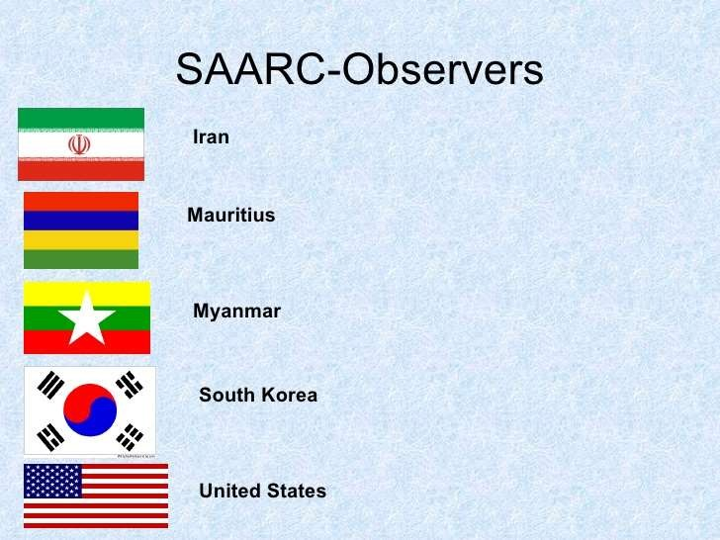

Slide 13




Slide 14


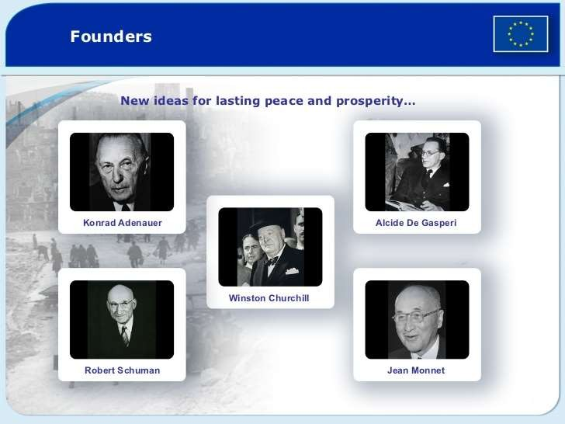

Slide 15



SETTING UP A COMMON MARKET.
CONTINUOUS AND BALANCED EXPANSION.
CLOSER RELATIONSHIP BETWEEN THE MEMBER STATE.

Slide 16




ELIMINATION OF CUSTOM DUTIES WITH REGARDS TO EXPORT & IMPORT.
ESTABLISHMENT OF CUSTOM TARIFF & COMMERCIAL POLICY.
ABOLITION OF ALL OBSTACLE FOR MOVEMENT OF PERSONS ,SERVICE & CAPITAL.
APPLICATION OF PROGRAM IN ORDER TO COORDINATE ECONOMIC POLICIES.

Slide 17

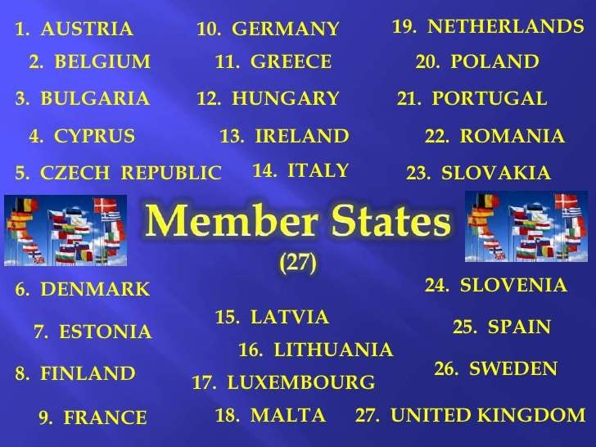

Slide 18


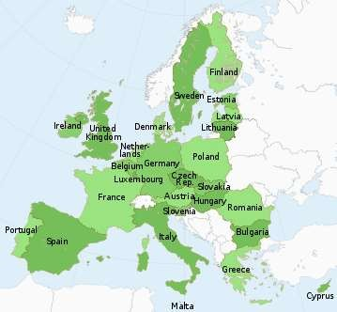

Slide 19


FOR SMOOTH RUNNING OF EXPORT ACTIVITIES
ESTABLISH A HEALTHY TRADE ENVIRONMENT.
ECONOMIC, SOCIAL AND CULTURAL DEVELOPMENT.

Slide 20


International business environment
(by: Francis cherunilam).
Nafta.org.in
Sarrc.org.in

Slide 21


